Slide 1


3.2 Probability Distributions and Probability Mass Functions
1. Verify that the following function is probability mass functions, and determine the requested probabilities.

Slide 2
3.2 Probability Distributions and Probability Mass Functions
2. A disk drive manufacturer sells storage devices with capacities of one terabyte, 500 gigabytes, and 100 gigabytes with probabilities 0.5, 0.3, and 0.2, respectively. The revenues associated with the sales in that year are estimated to be $50 million, $25 million, and $10 million, respectively. Let X denote the revenue of storage devices during that year. Determine the probability mass function of X.

Slide 3
3.2 Probability Distributions and Probability Mass Functions
3. Marketing estimates that a new instrument for the analysis of soil samples will be very successful, moderately successful, or unsuccessful with probabilities 0.3, 0.6, and 0.1, respectively. The yearly revenue associated with a very successful, moderately successful, or unsuccessful product is $10 million, $5 million, and $1 million, respectively. Let the random variable X denote the yearly revenue of the product. Determine the probability mass function of X .

Slide 4
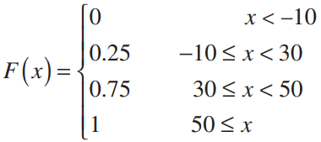
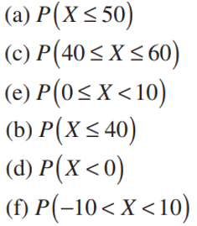
3.3 Cumulative Distribution Functions
4.

Slide 5
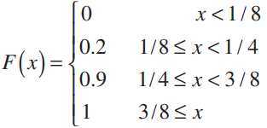

3.3 Cumulative Distribution Functions
5. The thickness of wood paneling (in inches) that a customer orders
is a random variable with the following cumulative distribution function:
Determine the following probabilities:

Slide 6
3.4 Mean and Variance of a Discrete Random Variable
6. The range of the random variable X is [0,1,2,3,x] where x is unknown. If each value is equally likely and the mean of X is 6, determine x.

Slide 7
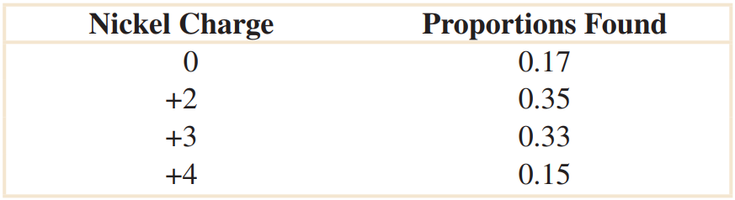
3.4 Mean and Variance of a Discrete Random Variable
7. In a NiCd battery, a fully charged cell is composed of nickelic hydroxide. Nickel is an element that has multiple oxidation states. Assume the following proportions of the states:
(a) Determine the cumulative distribution function of nickel charge.
(b) Determine the mean and variance of the nickel charge.

Slide 8
3.5 Discrete Uniform Distribution
8. Let the random variable X have a discrete uniform distribution on the integers 0 ≤ x ≤ 99. Determine the mean and variance of X.

Slide 9
3.5 Discrete Uniform Distribution
9. Let the random variable X have a discrete uniform distribution on the integers 1 ≤ x ≤ 3. Determine the mean and variance of X.

Slide 10
3.5 Discrete Uniform Distribution
10. Thickness measurements of a coating process are made to the nearest hundredth of a millimeter. The thickness measurements are uniformly distributed with values 0.15, 0.16, 0.17, 0.18, and 0.19. Determine the mean and variance of the coating thickness for this process.

Slide 11
3.6 Binomial Distribution
11. Let X be a binomial random variable with p = 0.1 and n = 10. Calculate the following probabilities:

Slide 12
3.6 Binomial Distribution
12. A multiple-choice test contains 25 questions, each with four answers. Assume that a student just guesses on each question.
(a) What is the probability that the student answers more than 20 questions correctly?
(b) What is the probability that the student answers fewer than 5 questions correctly?

Slide 13
3.7 Geometric and Negative Binomial Distributions
13. The probability of a successful optical alignment in the assembly of
an optical data storage product is 0.8. Assume that the trials are independent.
(a) What is the probability that the first successful alignment requires exactly four trials?
(b) What is the probability that the first successful alignment requires at most four trials?
(c) What is the probability that the first successful alignment requires at least four trials?

Slide 14
3.7 Geometric and Negative Binomial Distributions
14. In a clinical study, volunteers are tested for a gene that has been found to increase the risk for a disease. The probability that a person carries the gene is 0.1.
(a) What is the probability that exactly four people need to be tested to detect two with the gene?
(b) What is the probability that four or more people need to be tested to detect two with the gene?
(c) What is the expected number of people to test to detect two with the gene?

Slide 15
3.8 Hypergeometric Distribution
15. A batch contains 36 bacteria cells and 12 of the cells are not capable of cellular replication. Suppose that you examine six bacteria cells selected at random without replacement.
a) What is the probability that three cells of the selected cells are able to replicate?
(b) What is the probability that at least one of the selected cells can not replicate?
(c) What are the mean and variance of the number of cells in the sample that can replicate?

Slide 16
3.9 Poisson Distribution
16. The number of views of a page on a Web site follows a Poisson distribution with a mean of 1.5 per minute.
(a) What is the probability of no views in a minute?
(b) What is the probability of two or fewer views in 10 minutes?

Slide 17
3.9 Poisson Distribution
17. Suppose that the number of customers who enter a bank
in an hour is a Poisson random variable, and suppose that
P(X = 0) = 0,05. Determine the mean and variance of X.

